Slide 1


Metadata
Data Management Workshop
May 1st, 2017
Gatineau, Quebec

Slide 2

What is Metadata?
WHO created the data?
WHAT is the content of the data?
WHEN were the data created?
WHERE is it geographically?
HOW were the data developed?
WHY were the data developed?
Notes:
Metadata is data about data. It describes the content, quality, condition, and other characteristics of a dataset.
Metadata records answer questions such as:
Why was the dataset created?
What processes were used to create the dataset?
What projection are the data in?
When were the data last updated?
Who created the data?
What scale was used?
What fields are in the table?
What do the values in those fields mean?
Who do I contact about getting more information about the data?
How do I obtain a copy of the data?
Do the data cost anything?
Are there any limitations to the data?
Metadata is a valuable tool. Metadata records preserve the usefulness of data over time by detailing methods for data collection and dataset creation. Metadata greatly minimizes duplication of effort in the collection of expensive digital data and fosters the sharing of digital data resources.

Slide 3
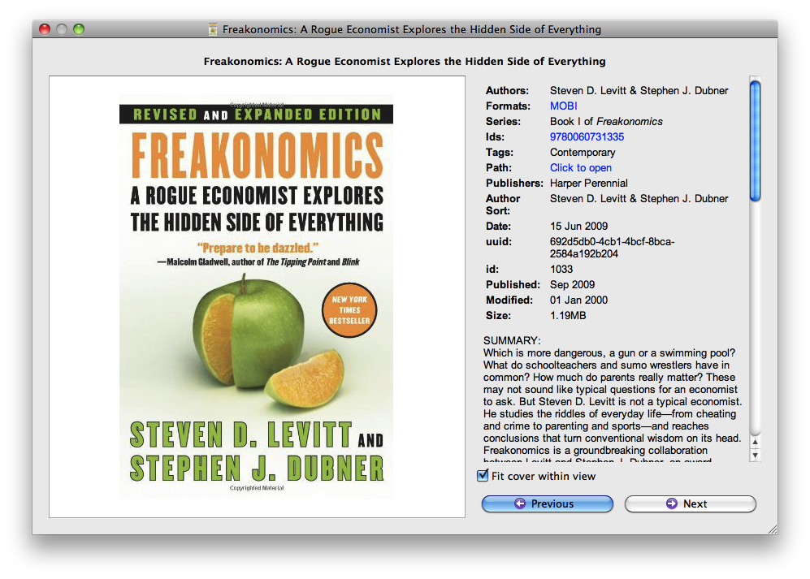
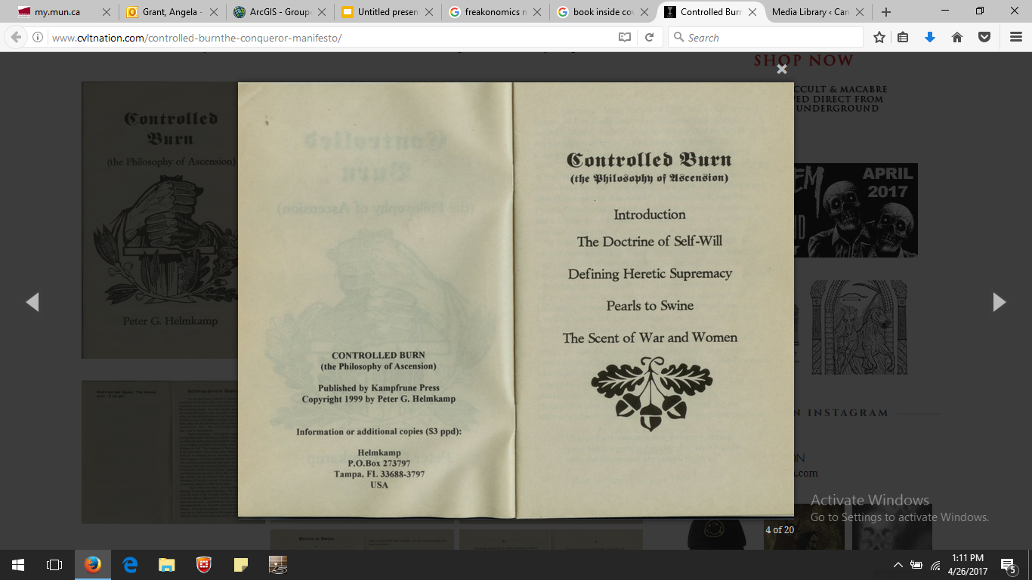
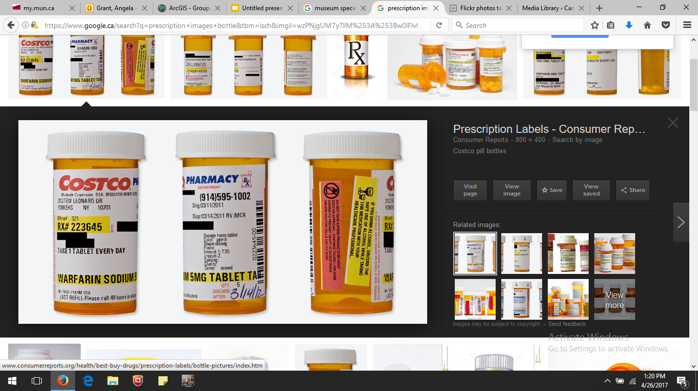
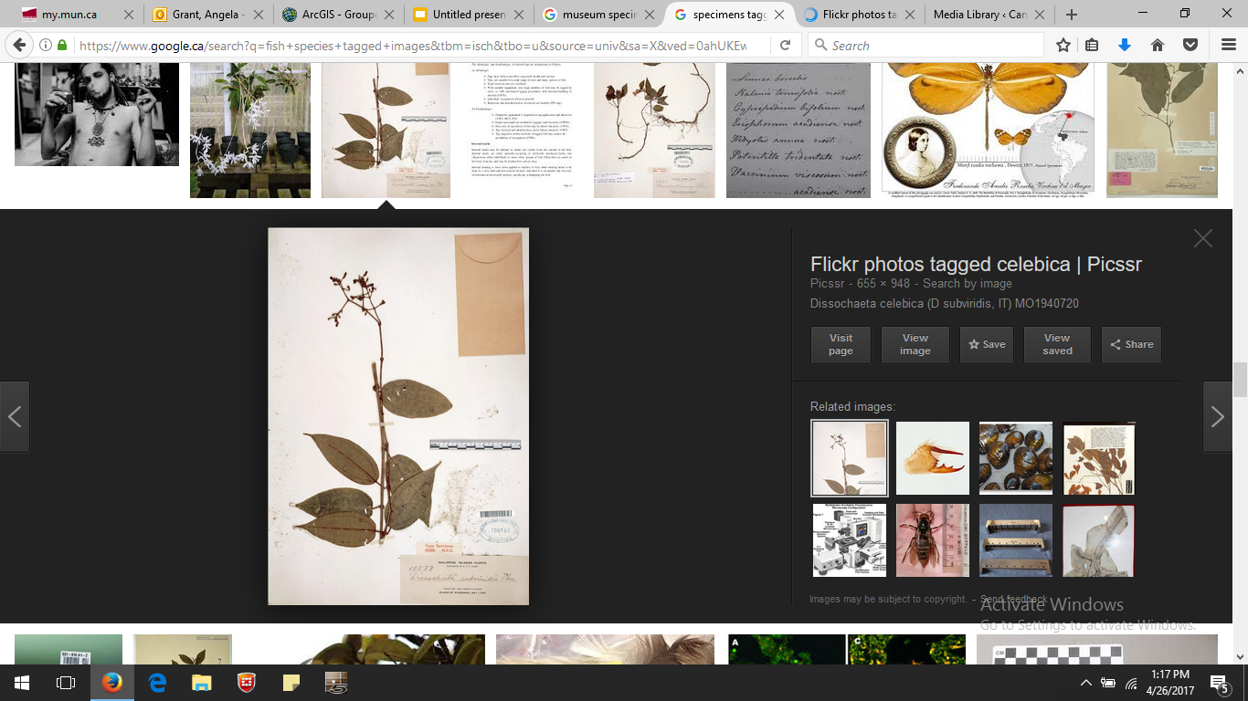
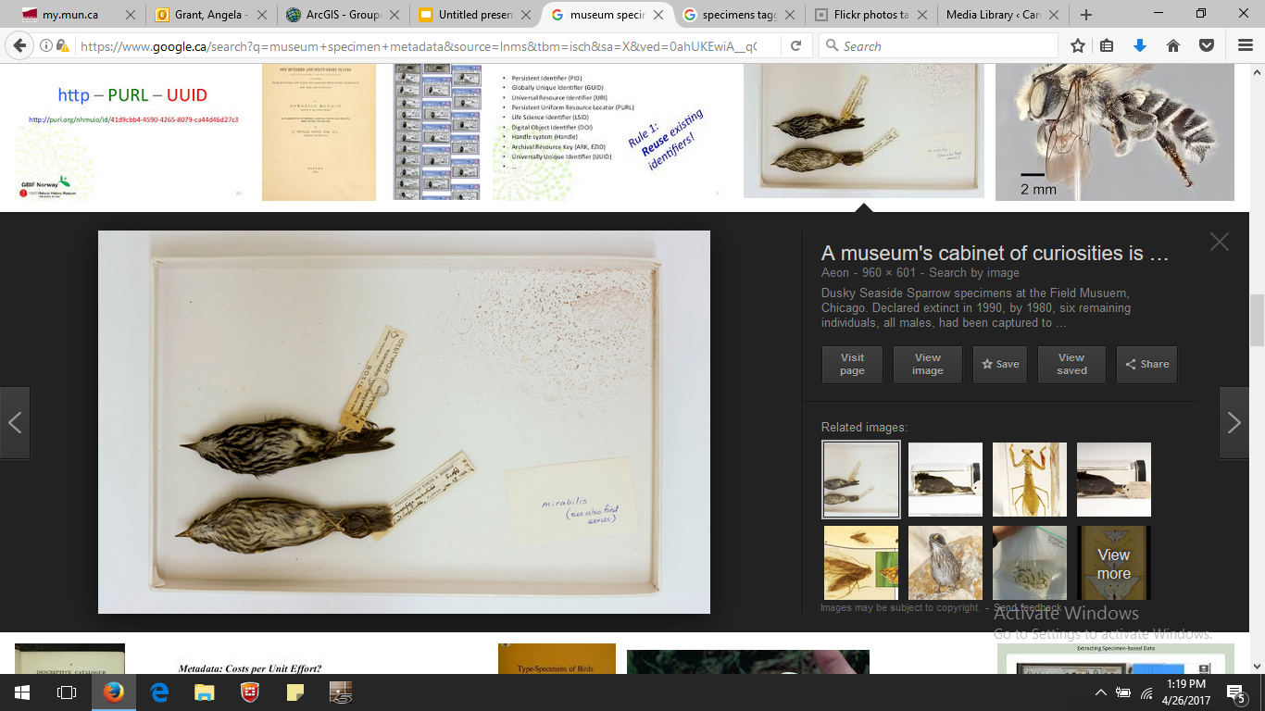
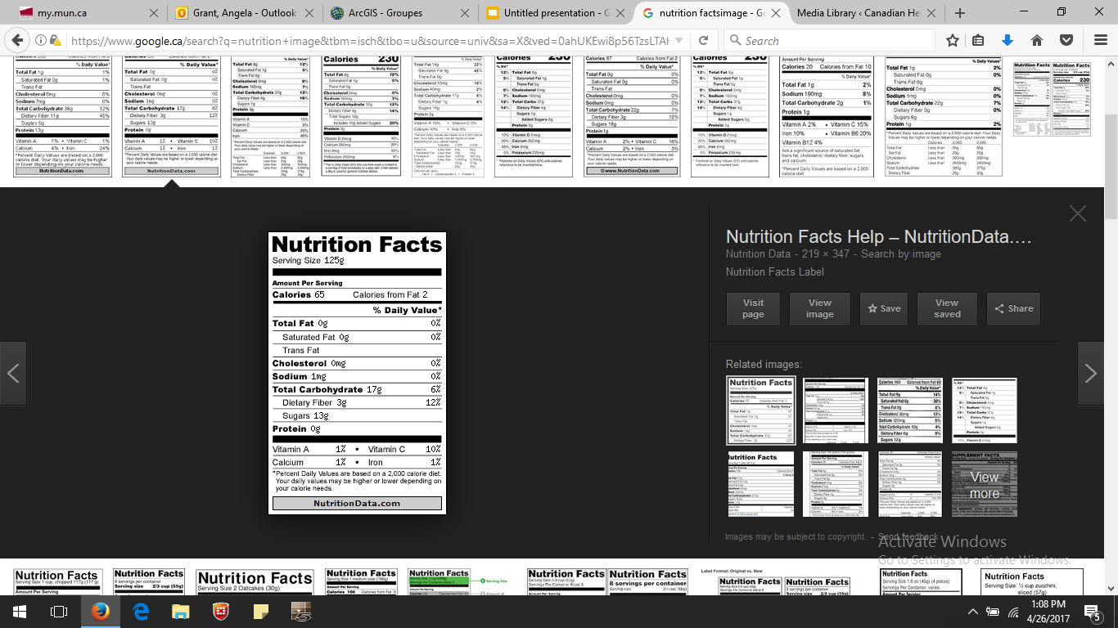
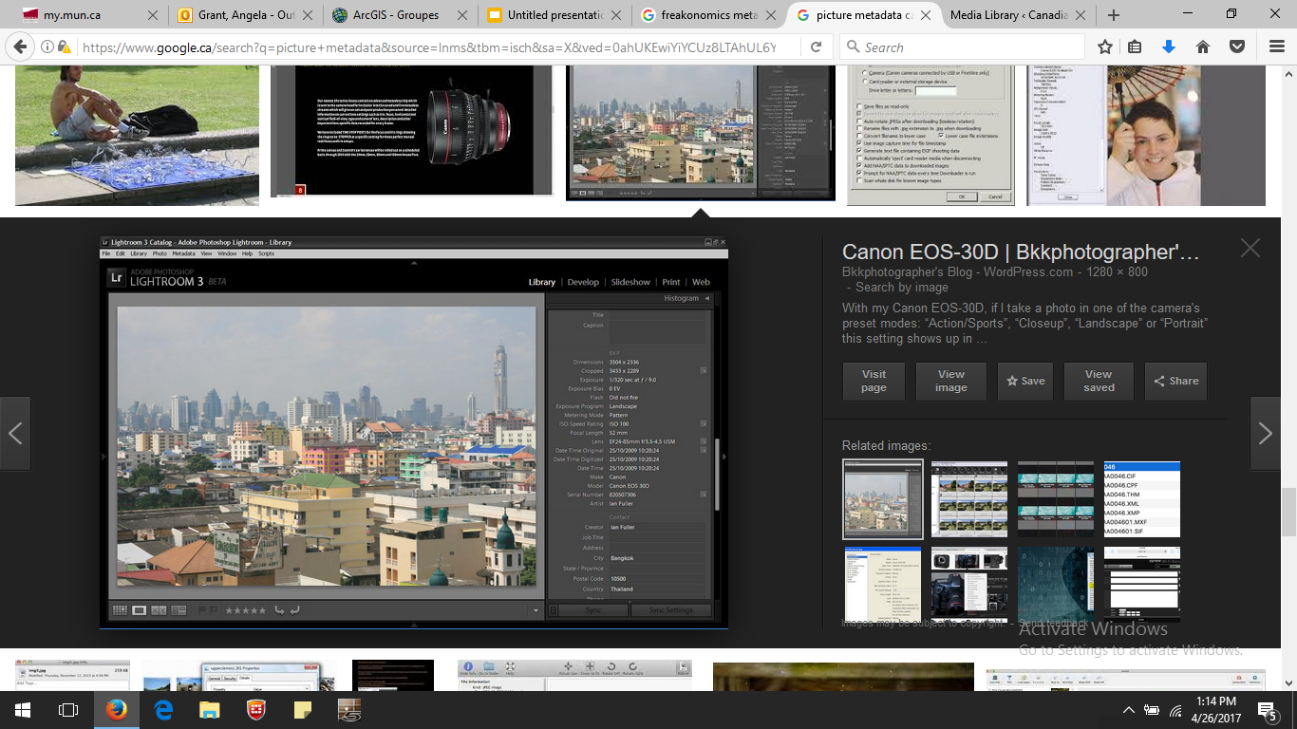
Metadata is everywhere..

Slide 4
Metadata
is data documentation
completes a dataset
captures critical information about the content of a dataset
essential for data to be discovered, accessed, and re-used
metadata standards provides structure and consistency to data documentation

Slide 5
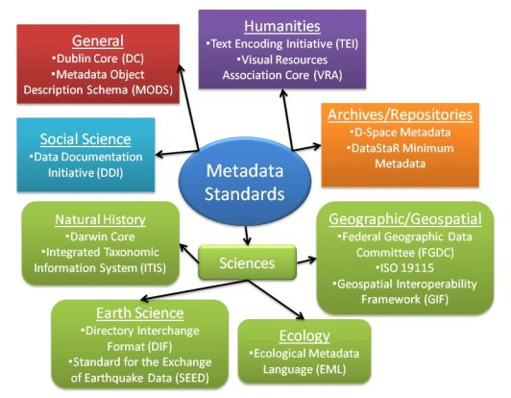
http://dal.ca.libguides.com/rdm

Slide 6
Metadata
Identification -- What is the name of the data set? Who developed the data set? What themes of information does it include? How current are the data?
Methodology – What methods were used to create/collect data? What equipment/software were used?
Data Quality -- How good are the data? What is the precision/accuracy? Is information available that allows a user to decide if the data are suitable for his or her purpose? Are the data complete? Were the data verified for quality control?
Spatial Reference – What geographic coverage is the data? Are coordinate locations encoded using longitude and latitude? What horizontal and vertical datums are used?
Temporal Reference – What temporal coverage is the data? Is data continuous or discrete?
Entity and Attribute Information -- What information is included? Were codes, acronyms or units of measure used? What do these mean?
Taxonomic Coverage -- What taxa are included in the data?
Access and Sharing -- From whom can I obtain the data? What formats are available? Are the data available online? What is the price of the data? Are there restrictions on accessing or using the data?

Slide 7
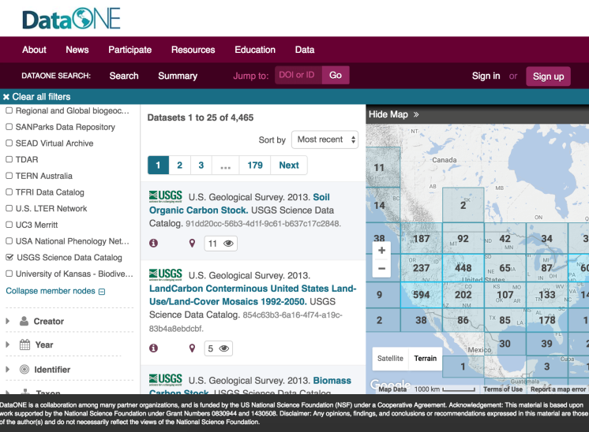
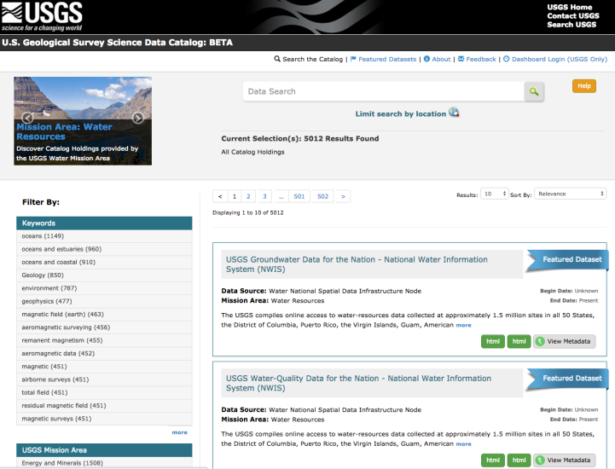
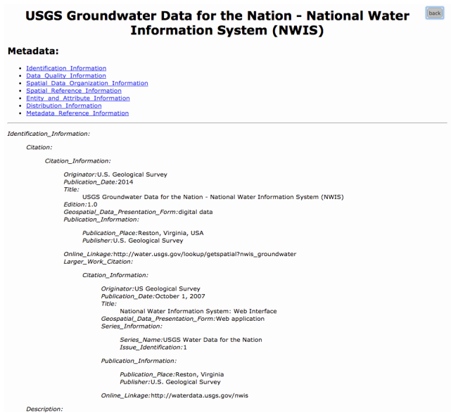
Metadata: What are they good for?
Data Discovery
Data Repository:
Enables exchange
e.g. Dryad
Data Catalog:
Enables discovery
e.g. CHONe website
Metadata:
Captures information
e.g. EML
Notes:
Metadata are essential for capturing information and data discovery. For example, a metadata record submitted to a catalog, such as the USGS Science Data Catalog, enables discovery of data; subsequently, the same metadata can be exchanged with broader data catalogs with services such as DataONE.
Elements such as Title, Description, and Keywords enable users to discover data based on topical searches. Spatial and temporal elements allow users to discover data based on the geographical location or the time period of the data.

Slide 8
Tips for Writing Quality Metadata
Metadata should be developed continuously throughout the
entire data lifecycle
Assure
Preserve
Discover
Integrate
Analyze
Plan
Describe
Collect
Notes:
Now that you know about some metadata standards to use and some available tools for developing metadata, let’s discuss some aspects of a good metadata record.
As mentioned at the beginning of this module, metadata should be developed continuously throughout the entire data lifecycle. This means that metadata should be generated along-side the data. Starting early will ensure that information about your data is fresh in your mind, which in turn saves you time. It will also enable you to provide more details about your data, which in turn leads to a higher-quality metadata record. For example, writing the Entity & Attributes section of your metadata or creating a separate data dictionary while you are developing your database will reduce this burden at the end of the project and can serve as a helpful tool during the project to ensure that everyone understands what each of the entities and attributes means. Writing the processing section of your metadata when you are processing your data ensures that all processing steps are documented. It is most beneficial if the person who is completing the data processing is the same person who writes the processing section for the metadata record.

Slide 9
Tips for Writing Quality Metadata
Which title is better?
“Crabs in the Atlantic ”
OR
“Occurrence of Green Crab in Gilbert Bay Marine Protected Area (2015-2016) CHONe Project 1.1.1”
“Occurrence of Green Crab (what) in Gilbert Bay Marine Protected Area (where) (2015-2016) (when) CHONe Project 1.1.1” (who)
Notes:
This example illustrates the importance of descriptive titles in metadata records.
The title “Greater Yellowstone Rivers from 1:126,720 Forest Visitor Maps (1961-1983)”, gives enough detail for a reader to discern whether they might like more information about your data from your metadata record.

Slide 10

Tips for Writing Quality Metadata
Which description is better?
“We checked our work and it looks complete. “
OR
“We checked our work using a random sample of 5 monitoring sites reviewed by 2 different people. We determined our work to be 95% complete based on these visual inspections.”
Be specific and quantify when you can!
The goal of a metadata is to give the user enough information to know if they can use the data without contacting the dataset owner.
Notes:
One goal of a metadata record is to give a reader enough information about your data, that s/he could re-use it without contacting you, the dataset owner.
“We checked our work and it looks complete” is too vague for a reader to assess quality control on the dataset, for example. More specific language gives the reader more information about how the data was collected and analyzed.

Slide 11
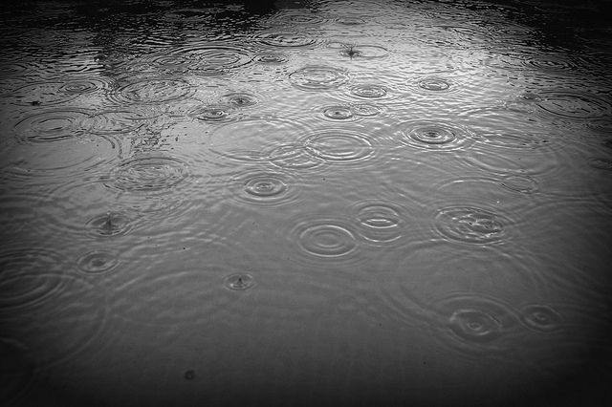
Tips for Writing Quality Metadata
Use Standard Vocabulary
Rainfall
Marine taxon (WoRMS)
Darwin Core terms
Place name and area (Marine Regions)
Rainstorm
Downpour
Showers
Rain
Drizzle
Precipitation
DataOne
Notes:
When possible, theme keywords should be drawn from thesauri or keyword lists. The use of authority files and standard vocabulary will help to make your metadata more discoverable, understandable, and interoperable. Make sure you reference the thesaurus used in your metadata record. Here are a few resources to get you started.

Slide 12
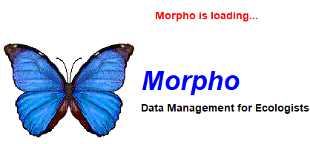
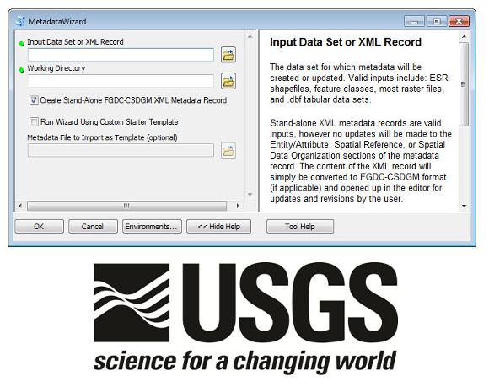
Tips for Writing Quality Metadata
Use a Metadata Tool
Morpho (EML, Darwin Core)
MetadataWizard (GIS data)
Notes:
When possible, theme keywords should be drawn from thesauri or keyword lists. The use of authority files and standard vocabulary will help to make your metadata more discoverable, understandable, and interoperable. Make sure you reference the thesaurus used in your metadata record. Here are a few resources to get you started.

Slide 13
Tips for Writing Quality Metadata
Consistency with commonly used fields
Examples for a FGDC CSDGM record:
Publisher:
✔
✗
<publish>U.S. Geological Survey</publish>
<publish>USGS</publish>
Date:
✗
✔
<pubdate>MM/DD/YYYY</pubdate>
<pubdate>May 27, 2003</pubdate>
<pubdate>YYYYMMDD</pubdate>
<pubdate>YYYY</pubdate>
Location:
✔
<placekt>Geographic Names Information System</placekt>
<placekey>Roosevelt National Forest</placekey>
<themekey>Roosevelt Forest</themekey>
✗
Notes:
As you get started developing your metadata record, it is important that certain fields are used consistently. This means that some metadata fields require values that are written the same way to aid in machine-readability and discovery. For example, the publisher field should contain the standard form of your agency’s or organization’s name (if that is the appropriate publisher). For example, the USGS, the name should be written as U.S. Geological Survey, not USGS.
For CSDGM records, all dates should be written using the format of four digits for year, then two digits for month, followed by two digits for the day (YYYYMMDD). Data.gov is enforcing this format and metadata will fail validation if other formats are used.
Select the keywords that are specific to your dataset. The thesaurus used should be documented in the metadata. If a single thesaurus does not provide all of the theme keywords that your metadata require, you may use and reference more than one thesaurus. Within FGDC CSDGM and ISO 19115 there are specific fields for place keywords. The theme keyword field should not be used for place keywords. A good resource for finding standard place keywords is the Geographic Names Information System.
If you need to include species names in your metadata, you may use the taxonomic section within the Biological Data Profile instead of the theme keyword fields, to do so.
Refer to the appropriate documentation and/or schema for the standard you are using, as well as with your agency/organization to ensure you following the recommended usage.

Slide 14
Steps to Create Quality Metadata
Organize your information
Did you write a project abstract to obtain funding for your proposal? Re-use it in your metadata!
Did you use a lab notebook to record measurements and other parameters?
Do you have the contact information for colleagues you worked with?
What about citations for other data sources you used in your project?
Write your metadata using a metadata tool
Review for accuracy and completeness
Have someone else read your record
Revise the record, based on comments from your reviewer
Review once more before you publish

Slide 15
Metadata Resources:
Data One: Education Modules
Dalhousie Library: Guide to Research Data Management
UBC Library: Research Data Management
Me (the Data Manager): angela.grant@mun.ca, 1-(709)-864-2298, or on the CHONe Slack page.

